Slide 1
System-based attacks
These are the attacks which are intended to compromise a computer or a computer network. Some of the important system-based attacks are as follows-
1. Virus
It is a type of malicious software program that spread throughout the computer files without the knowledge of a user. It is a self-replicating malicious computer program that replicates by inserting copies of itself into other computer programs when executed. It can also execute instructions that cause harm to the system.
2. Worm
It is a type of malware whose primary function is to replicate itself to spread to uninfected computers. It works same as the computer virus. Worms often originate from email attachments that appear to be from trusted senders.

Slide 2
3. Trojan horse
It is a malicious program that occurs unexpected changes to computer setting and unusual activity, even when the computer should be idle. It misleads the user of its true intent. It appears to be a normal application but when opened/executed some malicious code will run in the background.
4. Backdoors
It is a method that bypasses the normal authentication process. A developer may create a backdoor so that an application or operating system can be accessed for troubleshooting or other purposes.
5. Bots
A bot (short for "robot") is an automated process that interacts with other network services. Some bots program run automatically, while others only execute commands when they receive specific input. Common examples of bots program are the crawler, chatroom bots, and malicious bots.

Slide 3
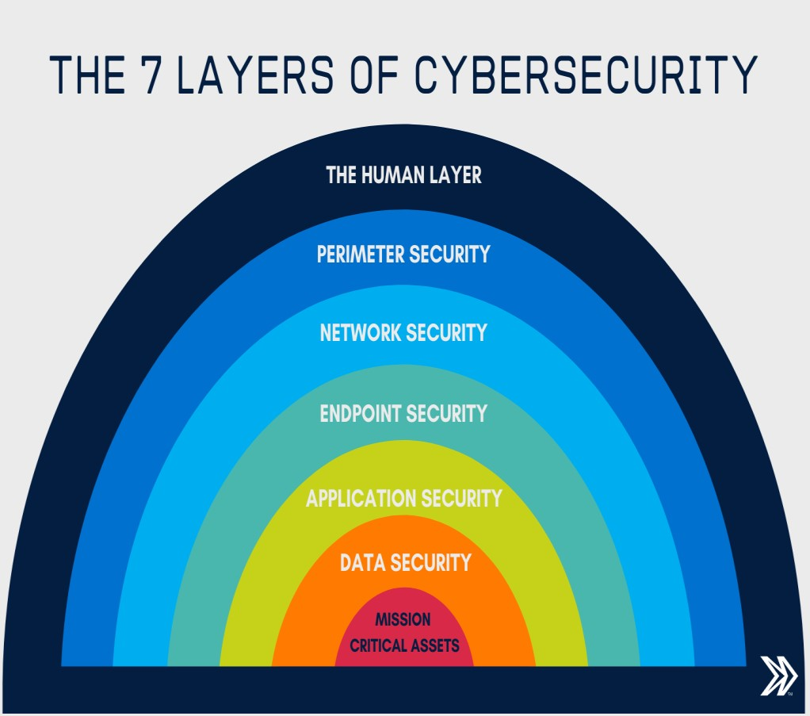

Slide 4
The 7 layers of cyber security should centre on the mission critical assets you are seeking to protect.
1: Mission Critical Assets – This is the data you need to protect
2: Data Security – Data security controls protect the storage and transfer of data.
3: Application Security – Applications security controls protect access to an application, an application’s access to your mission critical assets, and the internal security of the application.
4: Endpoint Security – Endpoint security controls protect the connection between devices and the network.
5: Network Security – Network security controls protect an organization’s network and prevent unauthorized access of the network.
6: Perimeter Security – Perimeter security controls include both the physical and digital security methodologies that protect the business overall.
7: The Human Layer – Humans are the weakest link in any cyber security posture. Human security controls include phishing simulations and access management controls that protect mission critical assets from a wide variety of human threats, including cyber criminals, malicious insiders, and negligent users.

Slide 5
Vulnerability, threat, Harmful acts
As the recent epidemic of data breaches illustrates, no system is immune to attacks. Any company that manages, transmits, stores, or otherwise handles data has to institute and enforce mechanisms to monitor their cyber environment, identify vulnerabilities, and close up security holes as quickly as possible.
Before identifying specific dangers to modern data systems, it is crucial to understand the distinction between cyber threats and vulnerabilities.
Cyber threats are security incidents or circumstances with the potential to have a negative outcome for your network or other data management systems.
Examples of common types of security threats include phishing attacks that result in the installation of malware that infects your data, failure of a staff member to follow data protection protocols that cause a data breach, or even a tornado that takes down your
company’s data headquarters, disrupting access.
Vulnerabilities are the gaps or weaknesses in a system that make threats possible and tempt threat actors to exploit them.

Slide 6
Types of vulnerabilities in network security include but are not limited to SQL injections, server misconfigurations, cross-site scripting, and transmitting sensitive data in a nonencrypted plain text format.
When threat probability is multiplied by the potential loss that may result, cyber security experts, refer to this as a risk.
SECURITY VULNERABILITIES, THREATS AND ATTACKS –
Categories of vulnerabilities
Corrupted (Loss of integrity)
Leaky (Loss of confidentiality)
Unavailable or very slow (Loss of availability)
– Threats represent potential security harm to an asset when vulnerabilities are exploited - Attacks are threats that have been carried out
Passive – Make use of information from the system without affecting system resources
Active – Alter system resources or affect operation
Insider – Initiated by an entity inside the organization • Outsider – Initiated from outside the perimeter

